Slide 1

Property Management System
Tanushree Kothari
Nupur Sinha
Preksha Beohar
Tsai-Mei Chen
Vijay Chacko
Team 5- Alpha Omega

Slide 2

Agenda
Business Case
Requirements Definition - Functional and Nonfunctional
Package and Class Diagram
Deployment Diagram
Database Schema
Use Cases, Sequence Diagrams and Screen Mock-ups
Testing Plan
Summary
References
Feedback/Questions

Slide 3


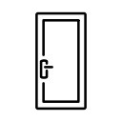


Business Case 1/2
Customers
Owners
Agency
Units
Tenants
Properties

Slide 4





Business Case 2/2
Rents Received
HAP Cash Check Other
1
12
17
26

Slide 5



Functional Requirements
Data Capture
Tenant and Lease
Property and unit
Record Rents received
Track Rental Payments
Multiple sources of payment
Unpaid rent
Adjustment of rent
Reporting
Payment History
Total Income
Past Due Amount
Tenants List
Vacant Unit List
Bad Leasing Units
Deposit Report

Slide 6




Nonfunctional Requirements
Operational
Cultural
Security
Performance
Notes:
References : https://www.outsystems.com/blog/truth-about-non-functional-requirements.html

Slide 7
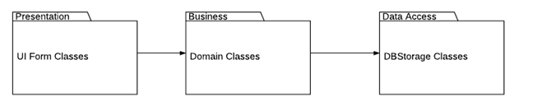
Package and Class Diagram

Slide 8
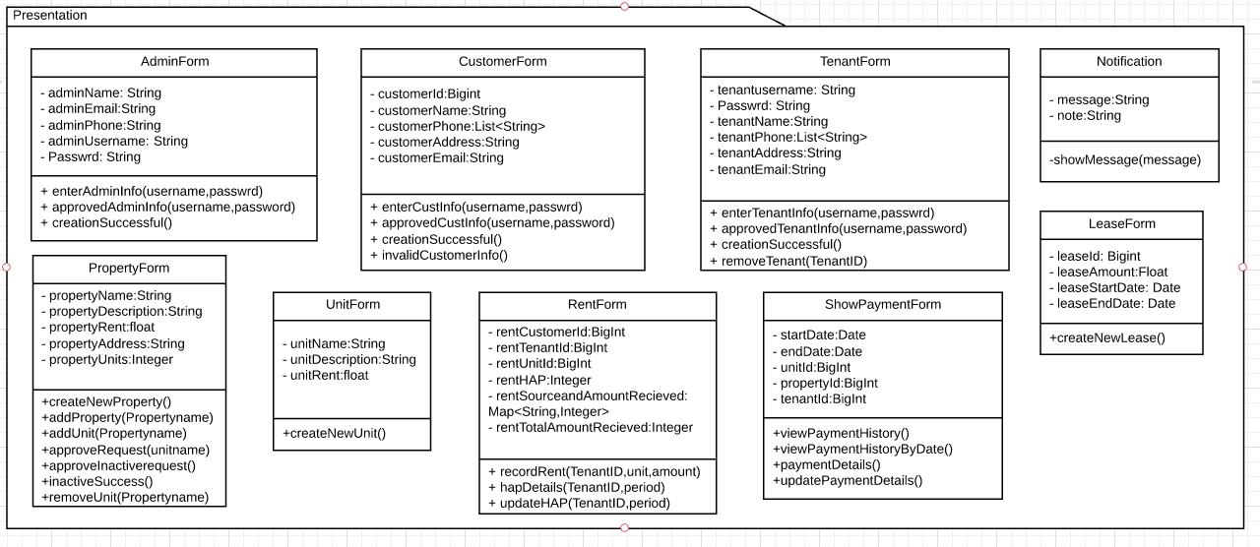
Package & Class Diagram- Presentation

Slide 9
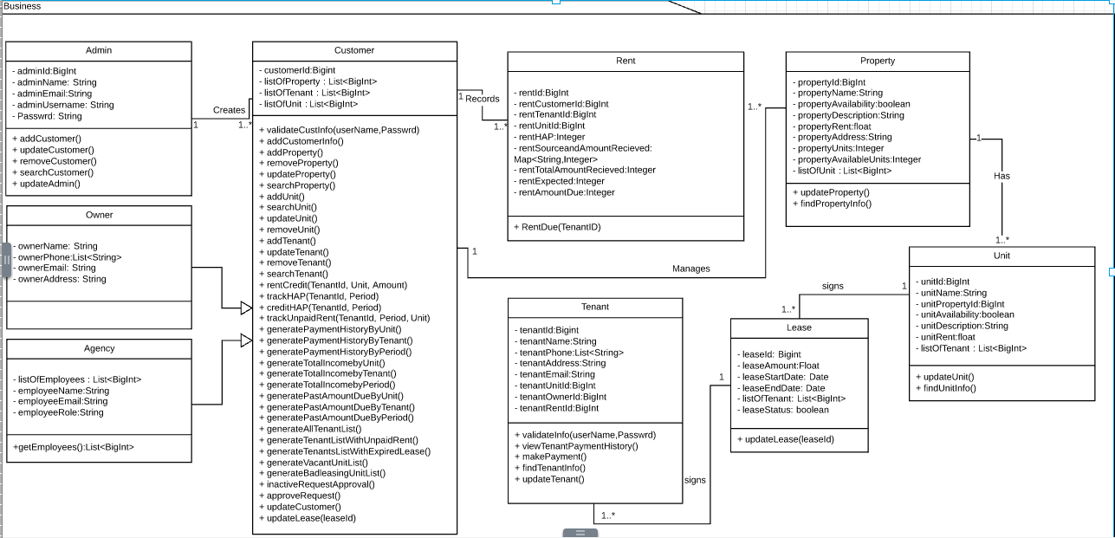
Package & Class Diagram- Business

Slide 10
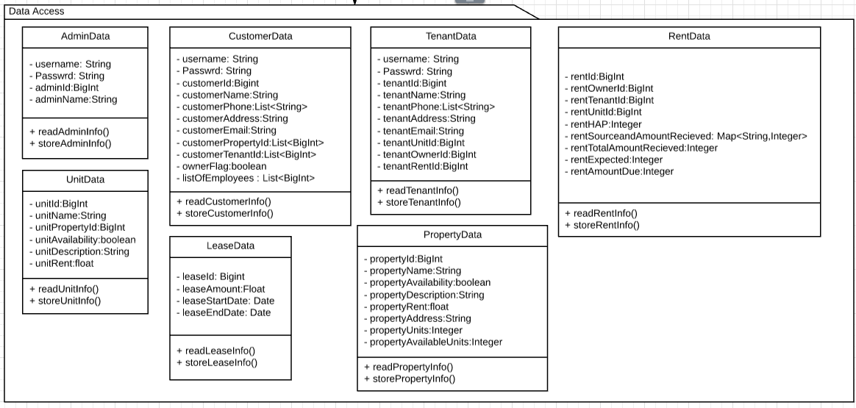
Package & Class Diagram- Data Access

Slide 11
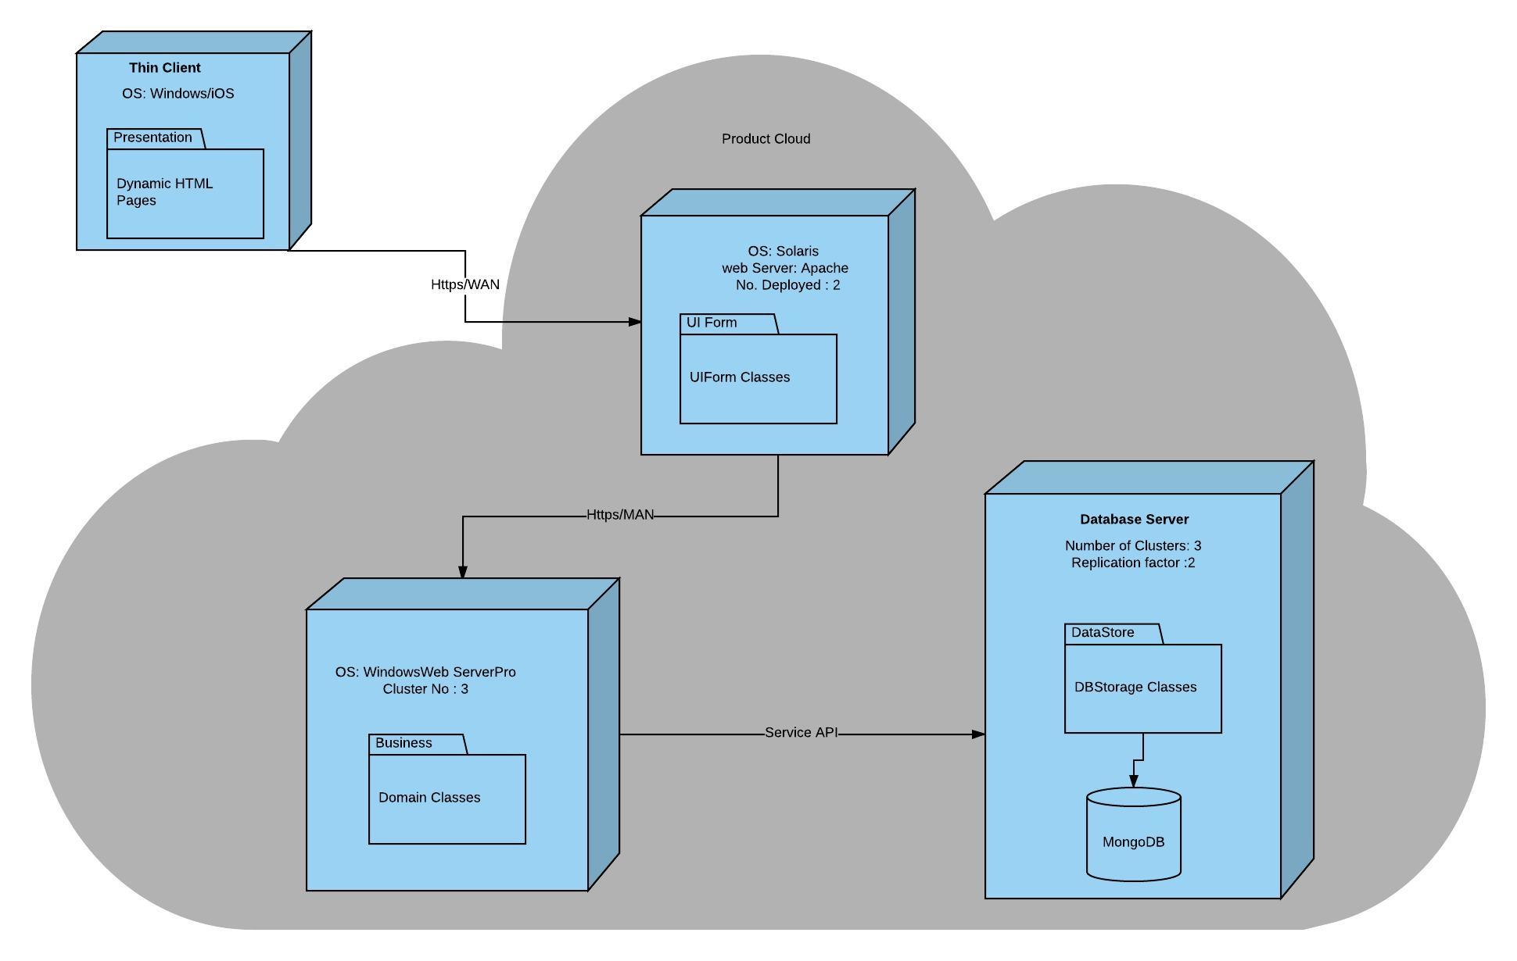
Deployment Diagram

Slide 12
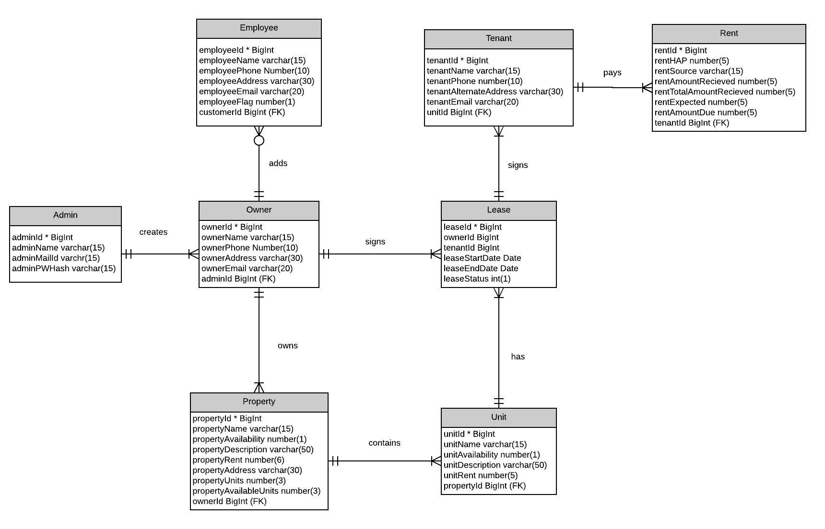
Database Schema

Slide 13
Use Cases
Add Customer
Add/Update/Remove/Search Property
Add/Update/Remove/Search Unit
Add/Update/Remove/Search Tenant
Track Rents/HAP/Unpaid Rent
Adjust Rent
Run Batch Jobs
Manage Lease
Generate Reports - 7 Reports
Login by Tenant
View Tenant Payment History
Make Payment by Tenant

Slide 14


Main Use Cases
Add Tenant
Add Property
Add Unit
Rent
Track Rent
Generate Payment History Report

Slide 15
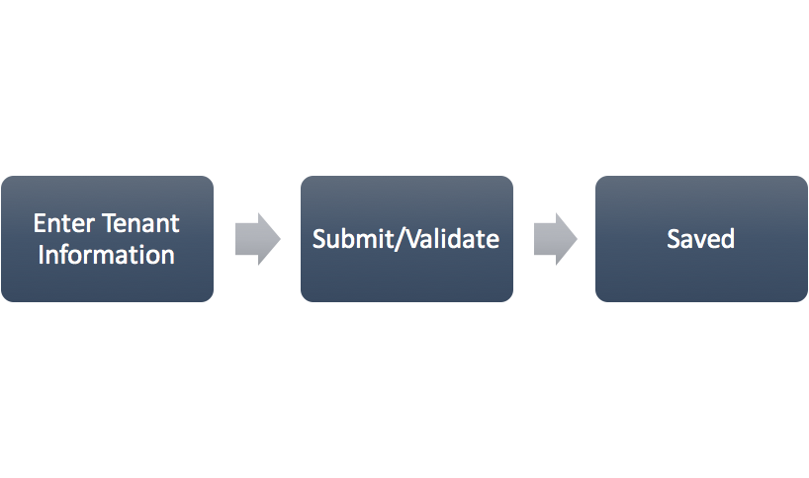
Add Tenant- Use Case
Notes:
1. Customer enters the detailed information of the tenant (first name, last name, phone numbers, deposit amount paid) and clicks on “Create New Tenant”
2. System displays a confirmation screen with message
3. System stores the Create New Tenant request in the datastore

Slide 16
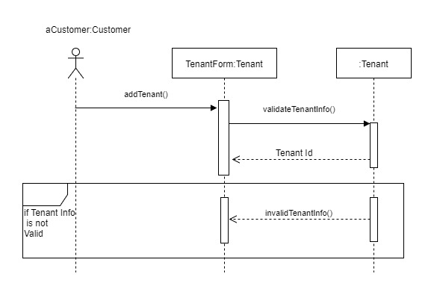
Add Tenant - Sequence Diagram

Slide 17
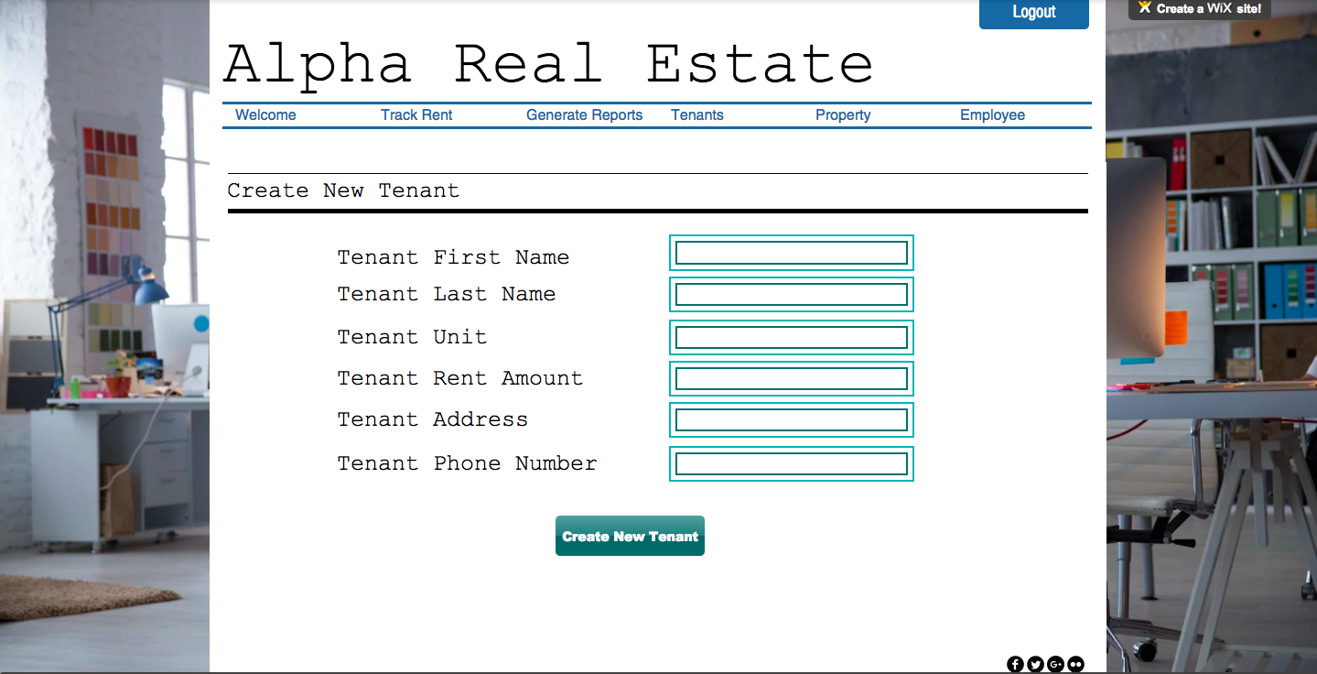
Add Tenant - Screen mock-up

Slide 18
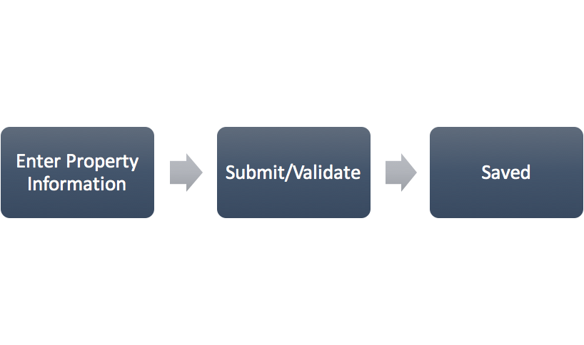
Add Property - Use Case

Slide 19
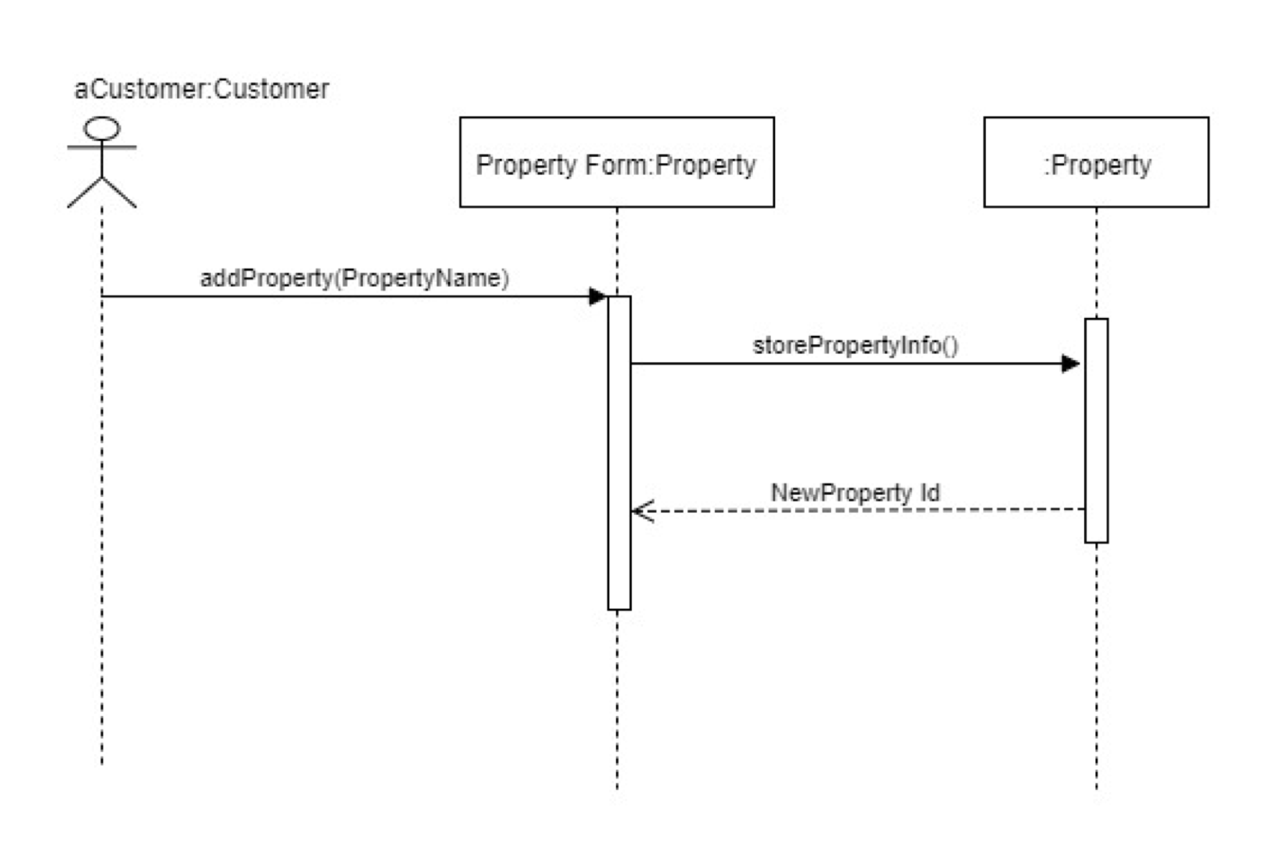
Add Property - Sequence Diagram

Slide 20
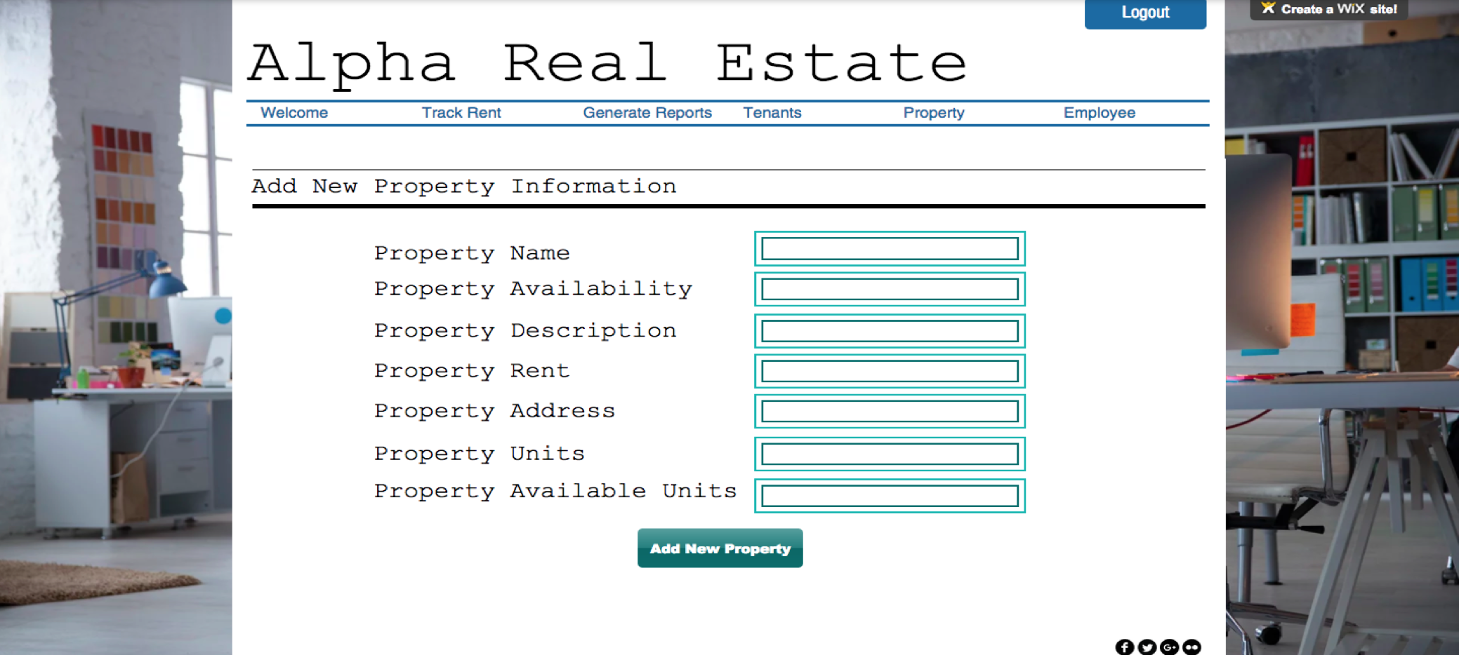
Add Property - Screen mock-up

Slide 21
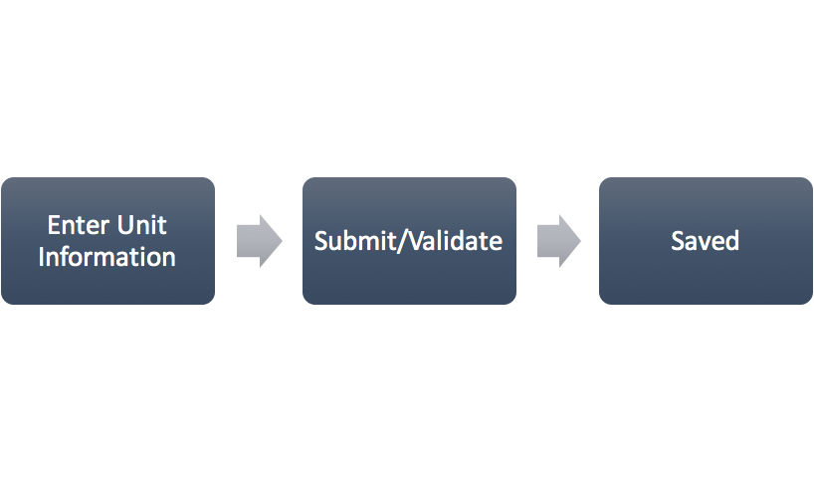
Add Unit - Use Case
Notes:
1. The customer enters the detailed information of the unit (address, unit number, and rent per month) and clicks on “Create New Unit”
2. System displays a confirmation screen with message
3. System stores the Add New Unit request in the datastore

Slide 22
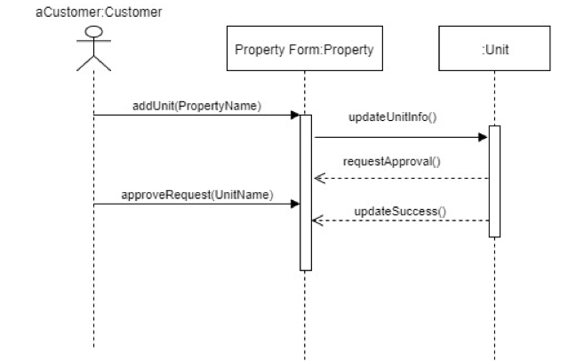
Add Unit - Sequence Diagram

Slide 23
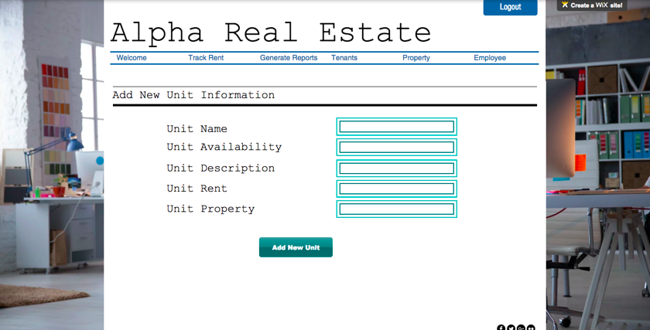
Add Unit - Screen mock-up

Slide 24
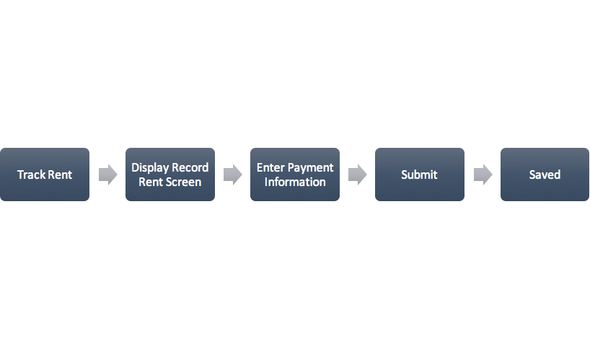
Track Rents - Use Case
Notes:
1. The customer clicks on ‘Record Rent’ option.
2. System displays record rent Screen
3. The customer enters Tenant Id, Unit No, amount of rent paid, Check no. if payment by check and then clicks on record rent
4. The System saves the rent paid record and generates a payment ID

Slide 25
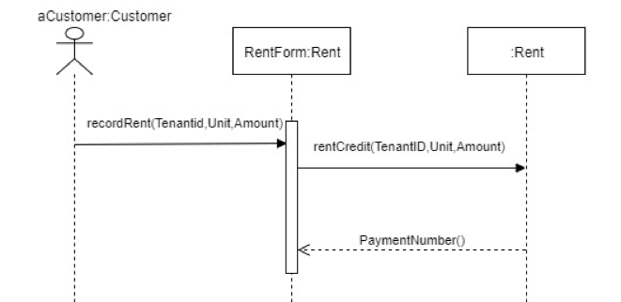
Track Rents - Sequence Diagram

Slide 26
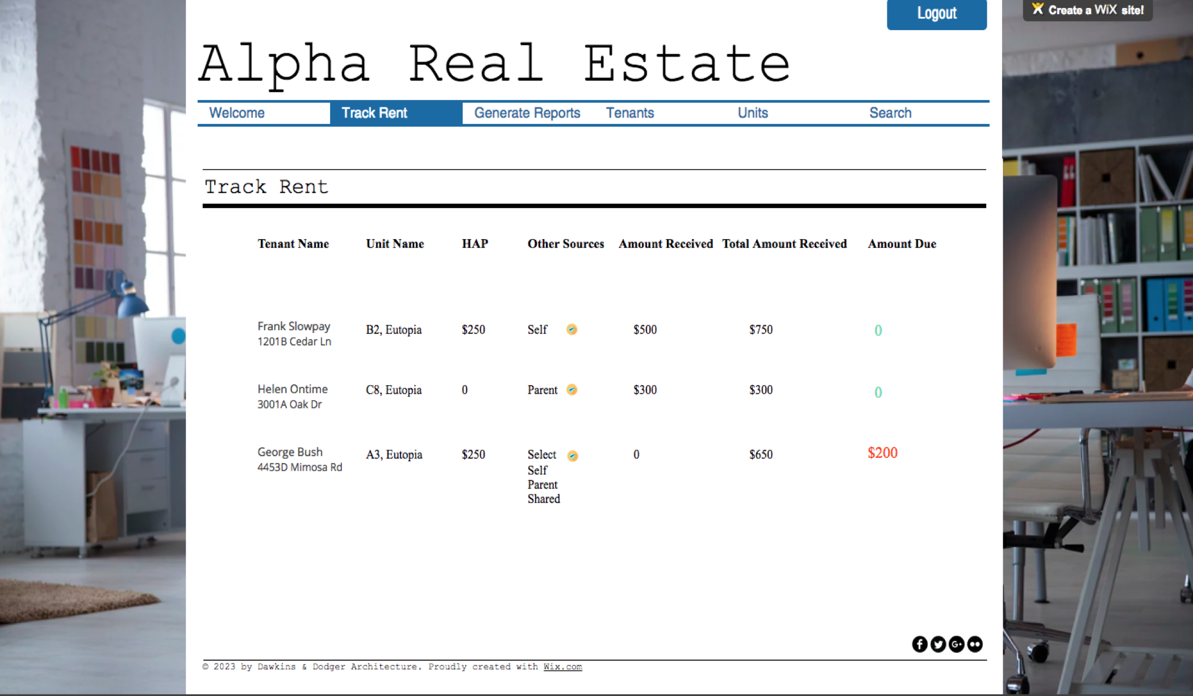
Track Rents - Screen mock-up

Slide 27
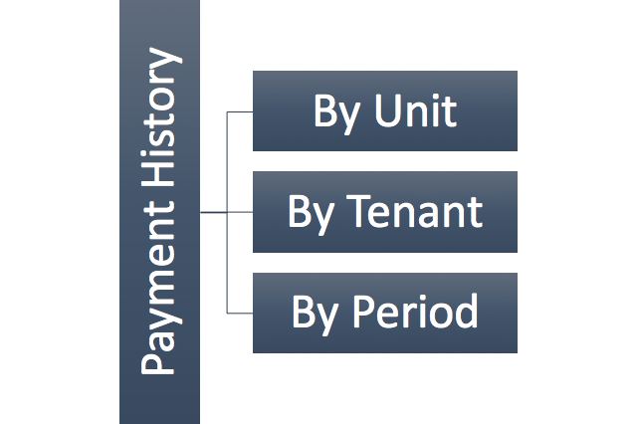
Generate Payment History - Use Case
Notes:
1. The system displays a list of various options (Payment History Report by unit, by tenant or by period) to choose from.
2. The customer clicks on “Payment History by unit” Report.
3. The system displays payment history by unit showing rent due, payments made, and balance due.
4. The customer clicks on “Payment History by tenant” Report.
5. The system displays payment history by tenant showing rent due, payments made, and balance due.
6. The customer clicks on “Payment History by period” Report and specifies the period to be a month or a duration of time.
7. The system displays payment history by period (period defined by the customer) showing rent due, payments made, and balance due.

Slide 28
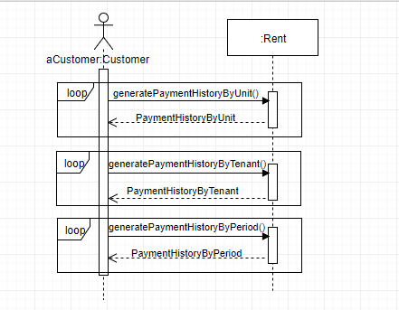
Generate Payment History - Sequence Diagram

Slide 29
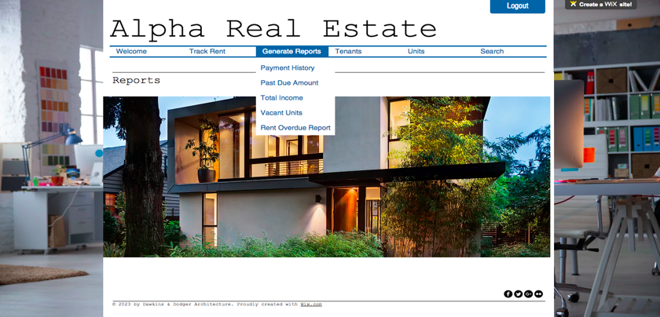
Generate Payment History -
Screen mock-up

Slide 30
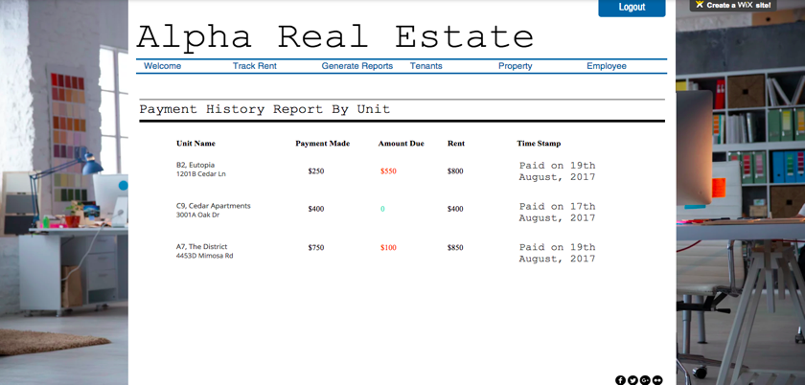
Payment History by Unit

Slide 31
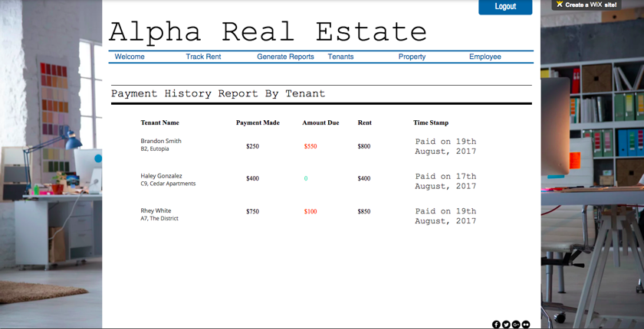
Payment History by Tenant

Slide 32

Payment History by Period

Slide 33
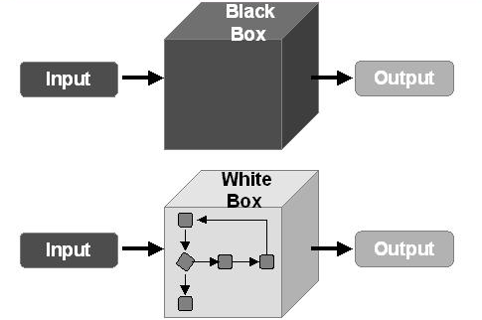

Testing Plan
Requirement:
Add Unit
Unit
Property
Notes:
Requirement: The system will allow the customer to add new units to the database.
Test Plan:
Will perform black box testing by providing both correct and erroneous data and the output will be evaluated.
Integration testing will be done with respect to Property and Unit class to see if the data is created successfully
White box testing will be done to see if code updates all variables as required.

Slide 34
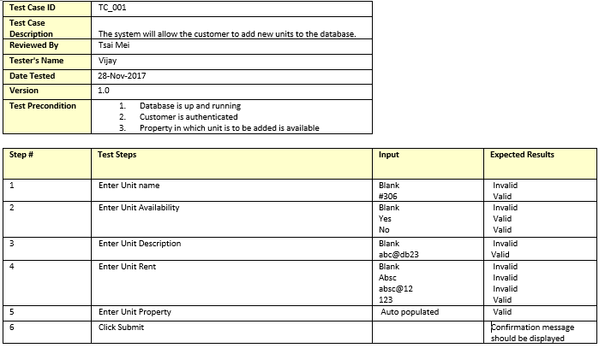
Test Case

Slide 35

Summary
Notes:
Simplified Rent Tracking
Easy User Interface, Easy navigation
Scalable
Real time access to information
Time saving
Security

Slide 36
References
https://www.iconfinder.com/
System Analysis and Design, Fifth Edition. By Alan Dennis, Barbara Wixom, and Roberta Roth
https://parim.co/aim-to-be-an-awesome-manager-by-giving-better-feedback
https://www.quora.com/What-is-the-best-marketplace-solution-that-fits-our-minimum-functional-requirements
https://www.shutterstock.com/search/health+benefits
https://www.guru99.com/download-sample-test-case-template-with-explanation-of-important-fields.html

Slide 37

Feedback/Questions

Slide 38


